Slide 1
Infant mortality rate in England and Indices of Deprivation analysis
Presented by:
Rachel Brimble, Jody-ann frazer, Shabana Qureshi and Ugochi Prince ajuobi
On
13th June 2023

Slide 2
Introduction
Child and infant mortality rates are crucial indicators of a population’s overall health and well-being, reflecting the effectiveness of healthcare systems, social policies, and economic conditions.
In today's presentation, we aim to delve into the intricate relationship between child and infant mortality rates and various indices of deprivation in England. Through our data analysis, we strive to uncover meaningful insights that can contribute to policy-making, public health initiatives, and the overall well-being of children in England.
Our findings have the potential to inform targeted interventions and strategies that address the socio-economic determinants of infant mortality rates, aiming for equitable health outcomes across diverse communities.
We look forward to sharing our research findings and highlighting any correlations, disparities, and implications discovered during our analysis.

Slide 3
Background AND CONTEXT
Child mortality refers to the death of children aged 1 to 4 years, whereas infant mortality refers to the death of infants under the age of 1 year.
For this research in England, we focus on 0 to 1-year-olds in the year 2021.
Our indices of deprivation as key determinants in understanding infant mortality rates are:
Percentage of Households below 60% of the Median Income (after housing costs)
By examining this, we can uncover crucial insights that will contribute to the development of evidence-based strategies and policies aimed at reducing infant mortality rates in England.

Slide 4
Data sources and collection
This research data is solely based on the 2021 public data on Infant Mortality in England for children 0 to 1 year old and sourced from:
https://www.ons.gov.uk/peoplepopulationandcommunity/populationandmigration/populatio[…]lationestimatesforukenglandandwalesscotlandandnorthernireland
https://www.ons.gov.uk/peoplepopulationandcommunity/birthsdeathsandmarriages/deaths/[…]ns/childhoodinfantandperinatalmortalityinenglandandwales/2021
Data sources: Office for National Statistics (ONS), local health authorities
Time frame: 2021
Sampling considerations: Representative samples from a different region

Slide 5
Research questions
What is the infant mortality rate in England per region?
Which region has the highest relative mortality rate per region in England?
Which region has the highest poverty rate in England?
Is there a link between the infant mortality rate and the poverty rate per region in England?

Slide 6
Data Cleaning and preparation

Slide 7
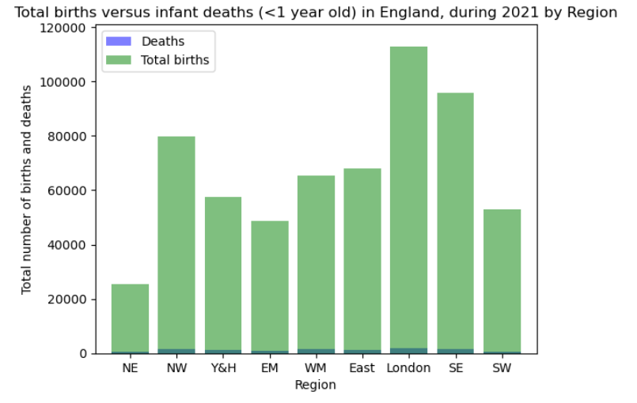
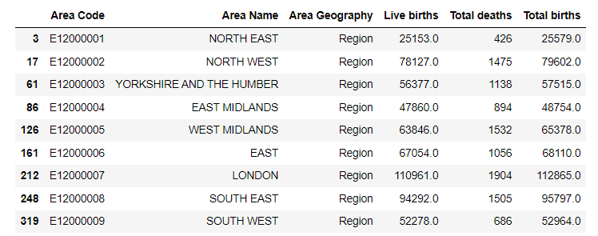
INFANT MORTALITY RATES
What is the infant mortality rate in England per region?
Identified required data
Visualised findings
Reviewed original hypothesis
Further interrogation of data
Notes:
B1-2: Identified number of births and deaths & Visualised findings
Data obtained through several steps:
Identified data through ONS spreadsheet. Initially, deaths split by groups e.g. stillborn, neonatal, peri / postnatal so combined data to ascertain total number of deaths and demographics included country, county, region, unitary authority etc.
Further reduced data to calculate total births (as excluded from original ONS data set) and return by region – this would be our unique identifier across our data sets
Plotted using bar graph
B3: Compared findings to original hypothesis
- Reviewed original hypothesis – believe mortality is greater in regions with higher indices of deprivation.
Observations of data: whilst graph visualises findings, data not relative thus meaningless.
Reset focus
B3: Further interrogation of data
Led to further revisions of data to ascertain relative frequency of deaths by region

Slide 8
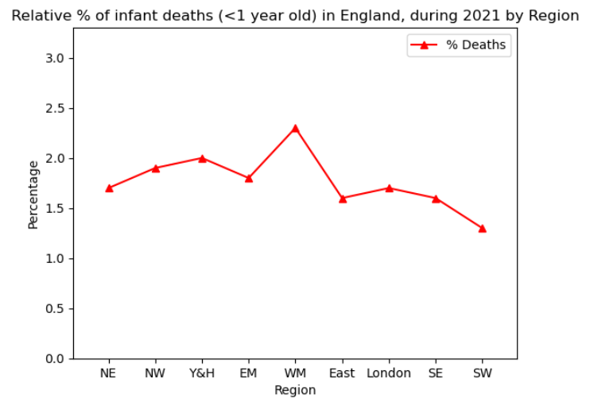
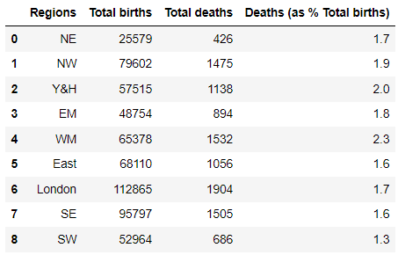
INFANT MORTALITY RATES Continued
What is the infant mortality rate in England per region?
Identified relative percentages (deaths as % of total births)
Findings:
West Midlands = highest
South West = lowest
Notes:
B1: Identifying relative percentages (deaths vs total births)
Identified by calculating the deaths as a percentage of total births.
B2: Findings
Observed that based on the total number of births:
West Midlands as a Region has the highest percentage of infant mortalities
South West as a Region has the lowest percentage of infant mortalities
Intro to next presenter (Jody-Ann): However, these figures are again presented in isolation and further analysis required to obtain and compare against the indices of deprivation and also infant population. Handover to Jody-Ann.

Slide 9
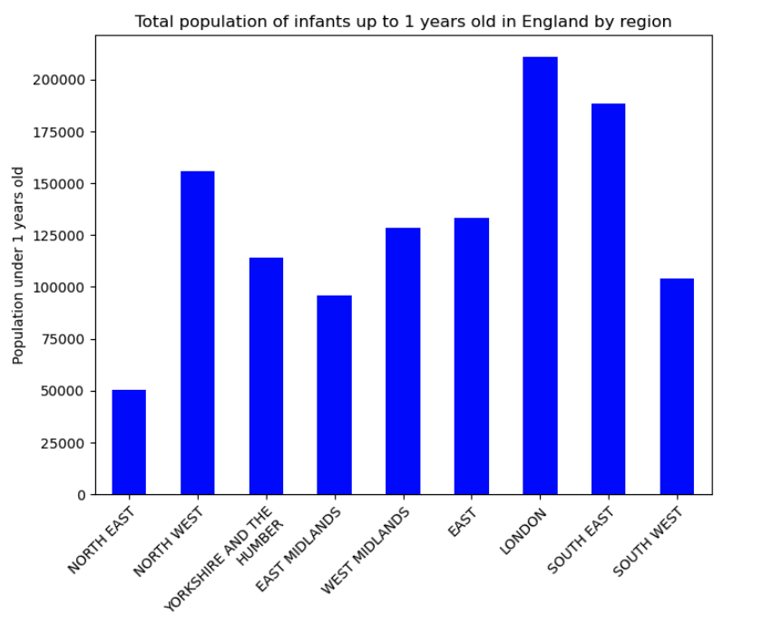
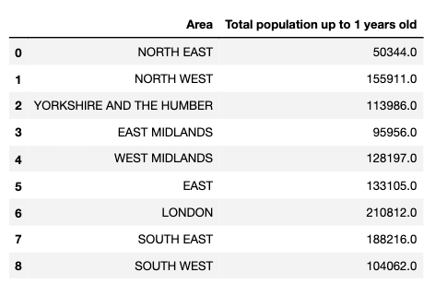
Population Data and analysis
Which region has the highest relative mortality rate per region in England?
We wanted each region to be relative to the population of infants. Therefore, we extracted the total population of infants per area in England. This showed that London had the largest population of infants

Slide 10
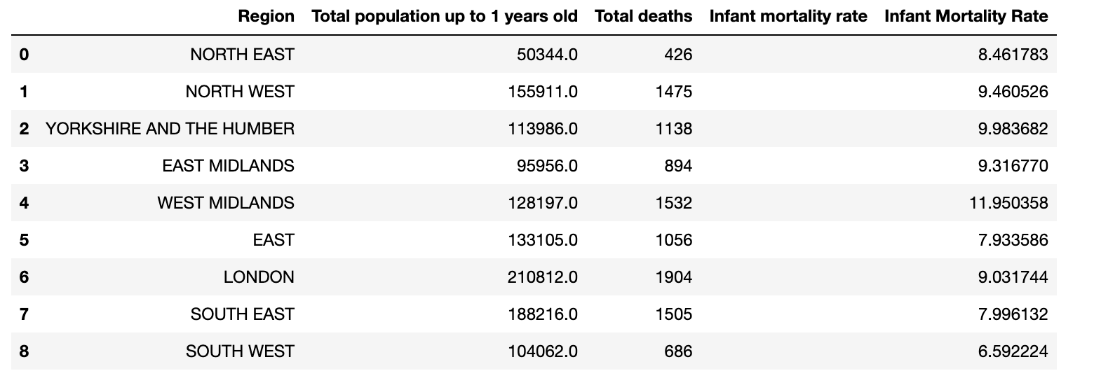
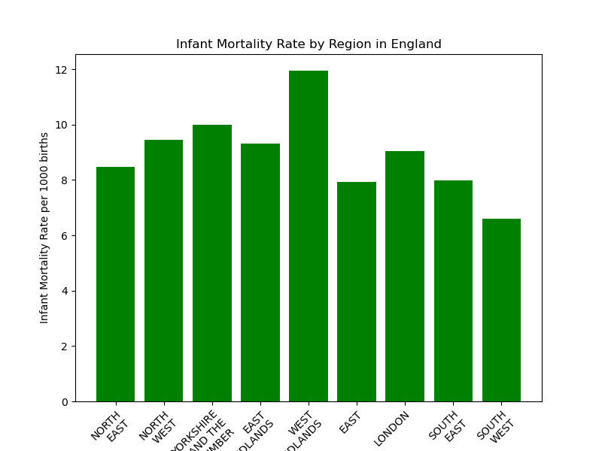
Data visualization
Data visualization
Which region has the highest relative mortality rate per region in England?
We determined the relative mortality rate per region and found out that West Midlands has the highest relative mortality rate in England per 1000 births within the total population.

Slide 11
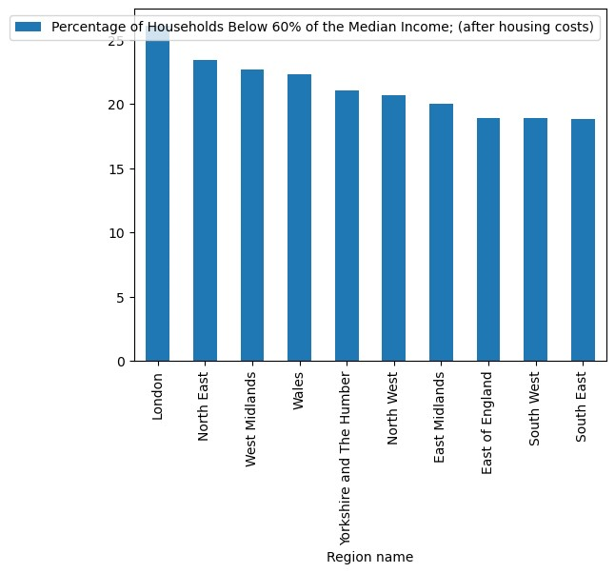
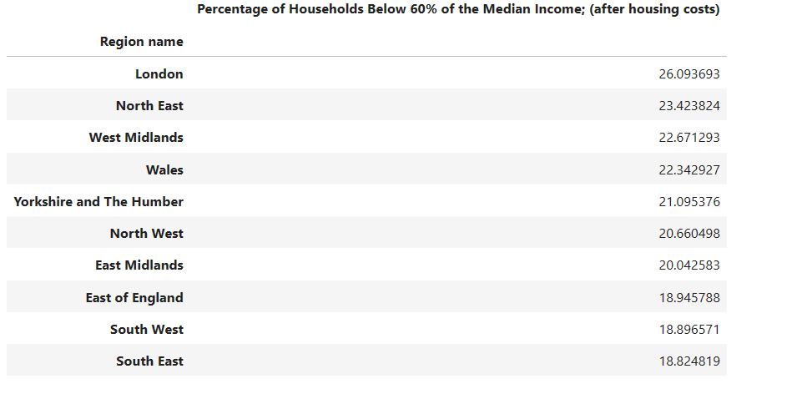
Data visualization
As you can see from the graph, percentage of households below 60% of the Median income were captured for a measure of levels of deprivation

Slide 12
Data visualization
Which region has the highest poverty rate in England?
West Midlands – was one of the third with percentage of households below 60% of the Median income, which suggests poverty can be one indicator of high numbers of child mortality within that region
Other factors could also include, ethnicity, geography, language and access to healthcare, however this would require an in depth analysis subjected to that region

Slide 13
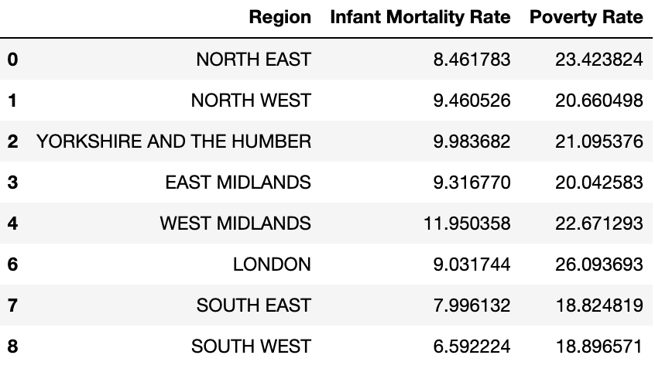
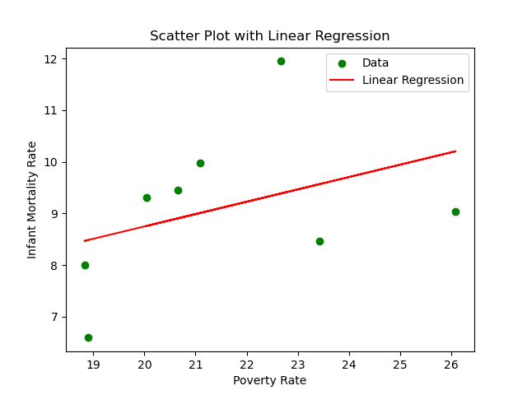
Data visualization
Is there a link between the infant mortality rate and the poverty rate per region in England?
The plot shows a general negative trend, suggesting that regions with higher poverty rates tend to have higher infant mortality rates.
The red regression line represents the linear relationship between the mortality rate and the poverty rate.

Slide 14
Analysis and conclusion

Slide 15
Our findings
Infant Mortality Rate: The highest infant mortality rate is observed in the 'WEST MIDLANDS' region, with a rate of 11.95 per 1000 births. The lowest infant mortality rate is found in the 'SOUTH WEST' region, with a rate of 6.59 per 1000 births.
Poverty Rate: The highest poverty rate is recorded in the 'LONDON' region, with a rate of 26.09%. The lowest poverty rate is observed in the 'SOUTH WEST' region, with a rate of 18.90%.
Relationship between Infant Mortality Rate and Poverty Rate:
The 'SOUTH WEST' region has both the lowest infant mortality rate and the lowest poverty rate, suggesting a potential relationship between lower poverty rates and better health outcomes for infants.
On the other hand, the 'WEST MIDLANDS' region exhibits the highest infant mortality rate along with a relatively higher poverty rate, indicating a possible association between higher poverty rates and increased infant mortality.

Slide 16
Implications and recommendations
Overall, this analysis demonstrates the importance of addressing poverty and its potential impact on infant mortality rates, emphasizing the need for targeted interventions and policies to improve health outcomes for vulnerable populations.
Further analysis and statistical tests could be conducted to determine the strength and significance of the relationship between the infant mortality rate and the poverty rate while considering other socio economic conditions that may apply like available healthcare infrastructure, access to quality healthcare, etc.

Slide 17
Limitations
As with every research analysis, there are also limitations as to data and possible biases as there are other indices not covered in this analysis that could tilt the analysis further.

Slide 18
THANK YOU

